Slide 1
Automated Portfolio Generator
Guide Name:
Dr. Bishwajit
Team Members:
ABHISHEK SRIVASTAVA - 19BCE10071
V SURYA KUMAR - 19BCE10286
PRAVIR KADIAN - 19BCE10006

Slide 2
INTRODUCTION
What is Portfolio?
A Portfolio is more than a “Simple Resume”.
Great Tool for Personal Branding.
Portfolio website act as a showcase of our previous work samples, all the projects & papers link and the site itself is an example of on which tools and stacks we are skilled.
Reflect What you are.
A well-rounded programmer portfolio is a vital asset that can make all the difference when you’re competing with other hopefuls.

Slide 3
Automated Portfolio Generator
Automated Portfolio Generator is a easy to use Web Application, which allows individuals to create their own portfolio by simply filling the basic information.
It Include all the below features:
Creating an account & setup the profile.
Easy SignUp using Google & Github authentication.
Adding Basic Information, work experience, education details.
Include your Achievements & Skills.
Generating a Whole dedicated Website for the user.

Slide 4
EXISTING WORK WITH LIMITATIONS
Currently, there is nothing like portfolio generators, there are only websites like wordpress.
Wordpress is not reliable for generating portfolios, it’s more about blogging or business website.
Closest free tool found on the internet: https://crevado.com
But the website is only limited to create portfolios of graphic designers.
With the only feature of uploading the images & work (graphics).

Slide 5
Except for this, all the remaining websites only provide templates.
That is, user have to edit all the details from the downloaded copy of a webpage and will have to upload it on his own.
Examples of Website providing only templates are: https://startbootstrap.com
Hence, the options available in existing websites are very limited.

Slide 6
SUMMARY OF LAST PRESENTATION
On our previous presentation we introduced our very idea and the things we want to decipher via our web-app.
We also declared how we want our work to progress along with the distribution of our project into smaller segments such that efficiently we can obtain the necessary results step by step.
The primary question asked to us was regarding how our project is invariably different and unique from the existing softwares and what are the new features we tend to add to our web-app.
We shall now discuss on the existing works and its limitations followed by how we shall overcome these and construct a relatively better version with added features.

Slide 7
Proposed Work & Methodology
We are developing a Progressive Web Application (PWA) that allows user to get a fully functioning responsive portfolio made in them in just few clicks.
This will save a lot of time and resources and will be extremely beneficial for the one who are applying for jobs or internships.
Automate Portfolio Generator a service which allows you to create your portfolio in easiest way possible.

Slide 8
NOVELTY OF THE PROJECT
The project is unique because in maximum research papers this idea is not mentioned.
A portfolio can be created using technologies like wordpress but it’s not efficient
But it also requires skill so for a person from non technical background cannot use it.
Our project focuses makes work easy for all kind of professionals.

Slide 9
REAL TIME USAGE
The project is very useful in real life as these days all the jobs interview requests for a portfolio which shows all the work done by the candidate in interactive manner.
So portfolio has a lot of importance in technical fields as well as non technical fields and our project makes this process of creating portfolio very easy.

Slide 10
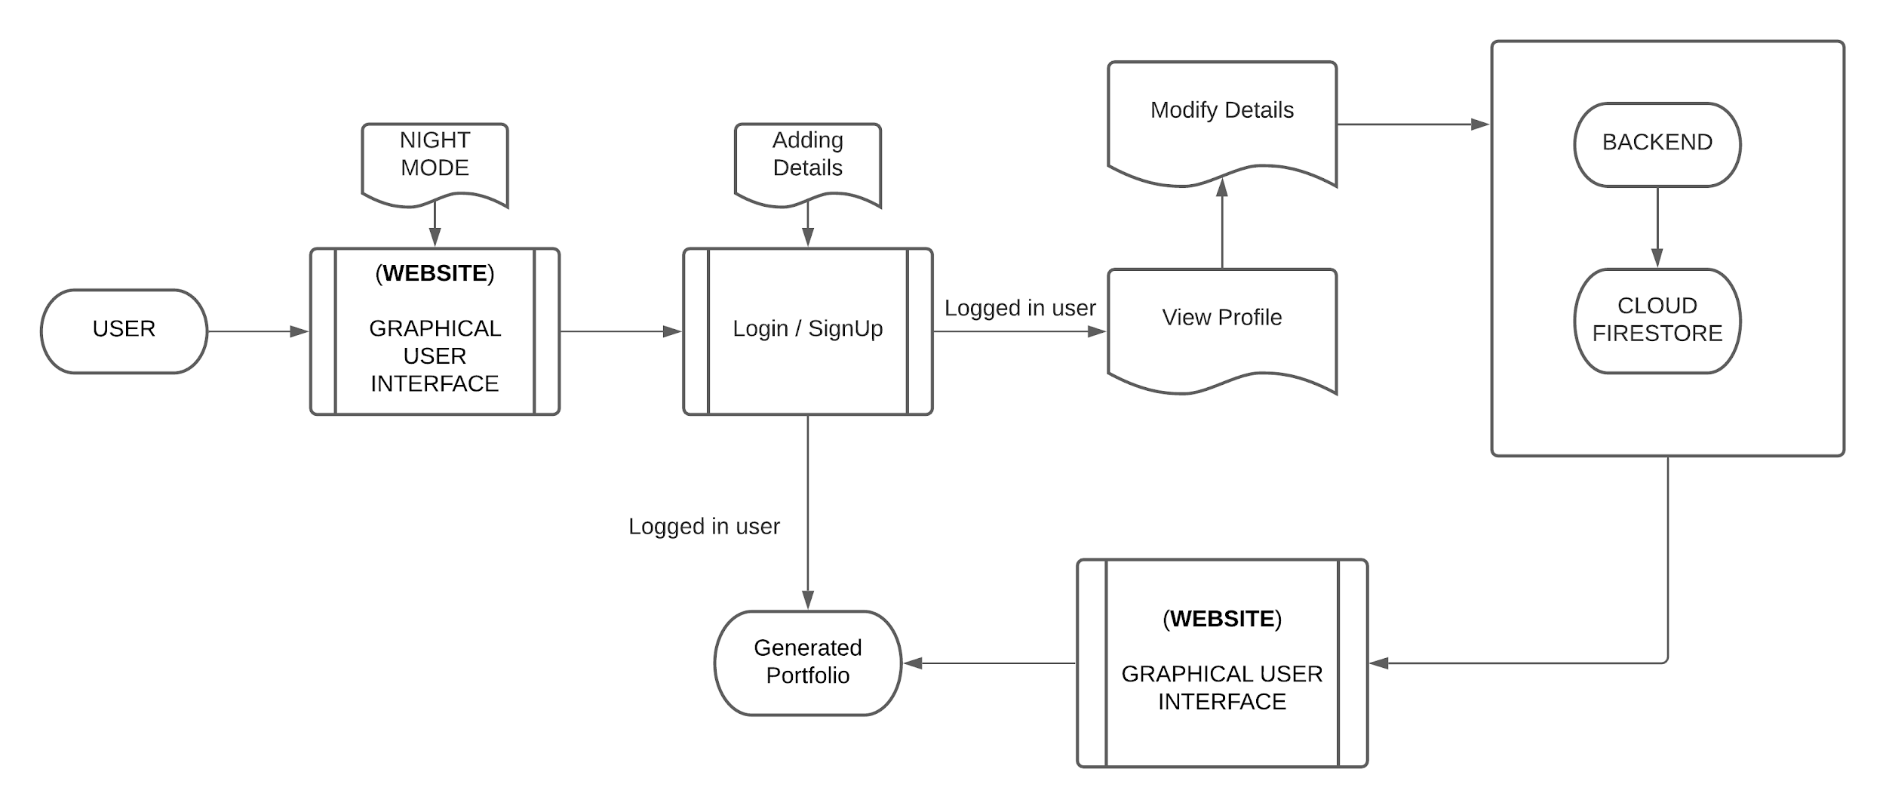
Architecture Diagram & Flow Diagram

Slide 11
ORGANISATION OF MODULES AND EXPLANATION
WEBSITE DESIGNING
USER AUTHENTICATION
STORING DATA AND GENERATE PORTFOLIO
WE HAVE DESIGNED WEBSITE USING HTML,CSS,
JAVASCRIPT,
REACT AND
MATERIAL UI.
USING FIREBASE TO PROVIDE USER AUTHENTICATION FUNCTIONALITY.
USING CLOUD FIRESTORE TO STORE AND FETCH USER’S DATA.
WE WILL CARRY OUT THE DETAILED EXPLANATION ALONG WITH THE LIVE DEMONSTRATION

Slide 12
HARDWARE & SOFTWARE REQUIREMENTS
The project involved the implementation of the following technologies:-
Language:
HTML
CSS
JS
Python
Framework:
REACT
Other:
FIREBASE
CLOUD FIRESTORE
MATERIAL UI

Slide 13
THANK YOU

